Slide 1
Bluestock Mutual Fund Analytics Capstone Project
Prepared By: Shruthi Meena
Technologies: Python | SQLite | Jupyter | Power BI | GitHub

Slide 2
Problem Statement & Objectives
Problem Statement
The mutual fund industry generates large volumes of data related to investments, fund performance, and investor behavior. An analytics solution is required to transform this data into actionable insights.
Objectives
Build ETL pipeline
Design analytical database
Perform EDA
Calculate performance metrics
Develop risk analytics
Build Power BI dashboard

Slide 3
Data Sources
Datasets Used
Fund Master
NAV History
Investor Transactions
Scheme Performance
AUM by Fund House
Monthly SIP Inflows
Category Inflows
Industry Folio Count
Benchmark Indices
Portfolio Holdings

Slide 4
Project Architecture
Workflow
Raw Data ↓ Data Cleaning (Pandas) ↓ Processed CSV Files ↓ SQLite Database ↓ EDA & Analytics ↓ Power BI Dashboard ↓ Final Insights

Slide 5
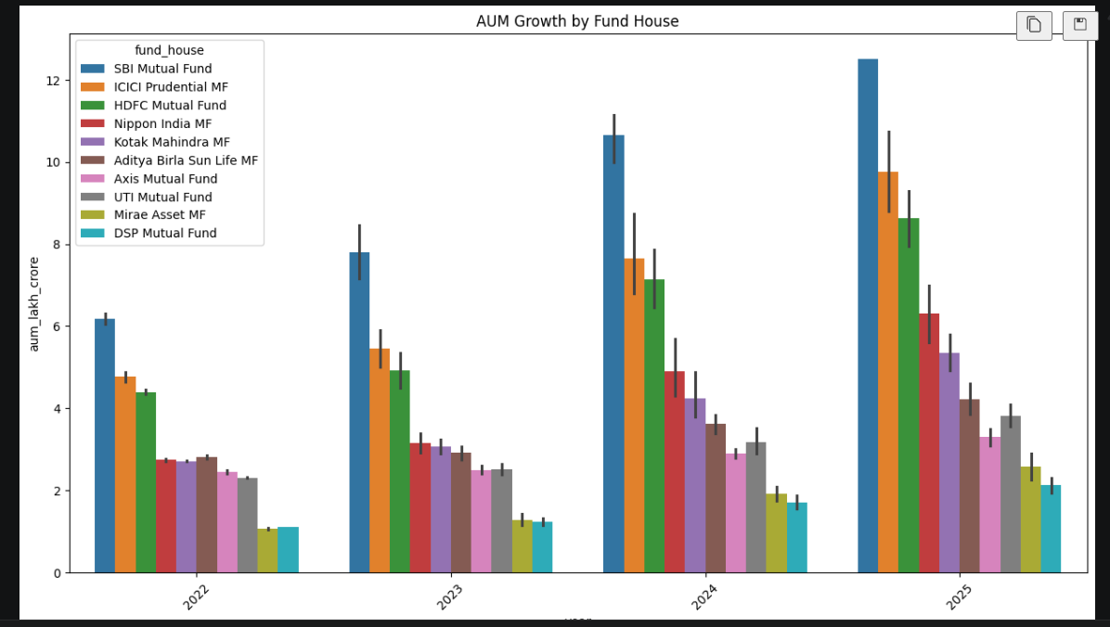
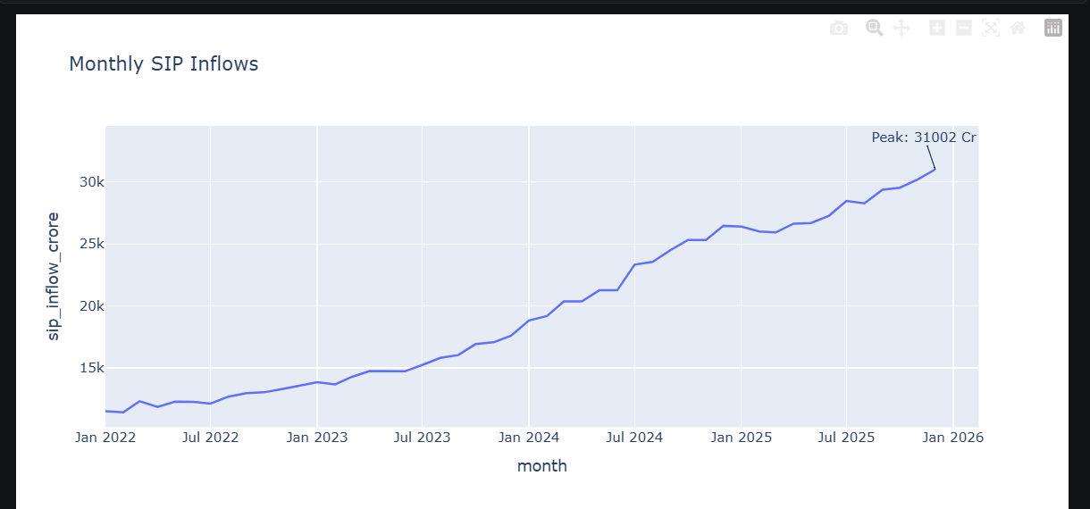
EDA Highlights (Industry Trends)
Key Insights
Industry AUM increased significantly
SIP inflows reached record levels
Folio count doubled during analysis period
Equity funds dominated inflows

Slide 6
EDA Highlights (Investor Analytics)
Key Insights
Middle-aged investors contributed highest investments
SIP participation increased consistently
Geographic investment concentration observed
Investor base expanded rapidly

Slide 7
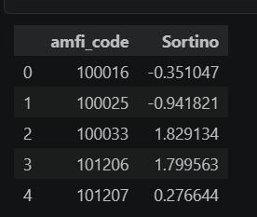
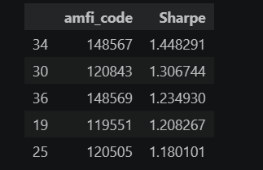
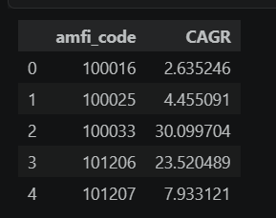
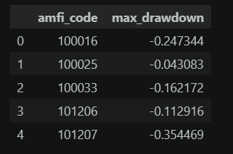
Performance Analytics
Metrics Calculated
CAGR (1Y, 3Y, 5Y)
Sharpe Ratio
Sortino Ratio
Maximum Drawdown
Findings
Top funds generated strong risk-adjusted returns
Sharpe Ratio effectively differentiated performance

Slide 8
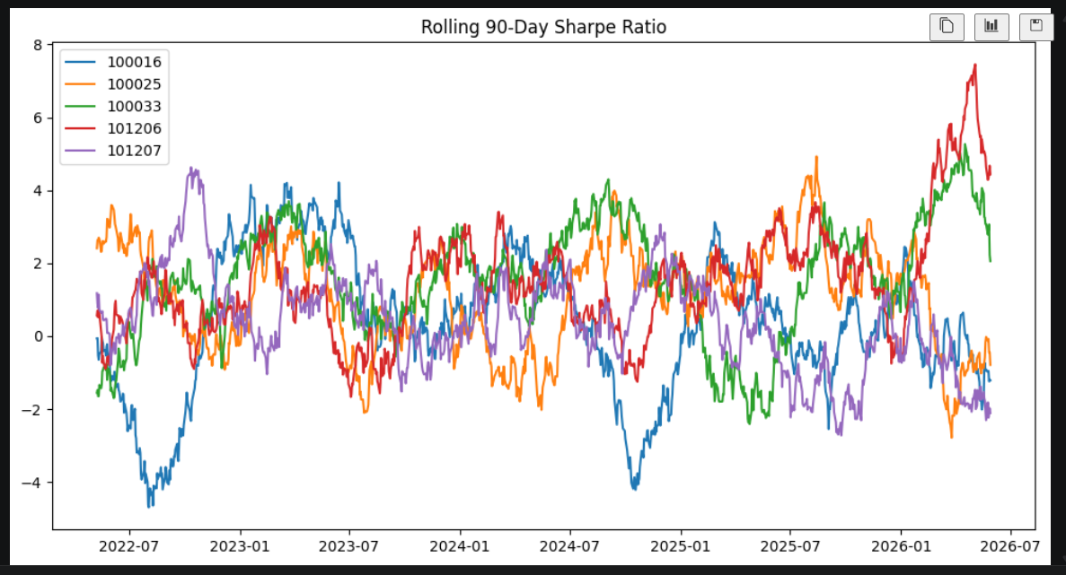
Advanced Analytics
Advanced Models
VaR (95%)
CVaR
Rolling Sharpe Ratio
Investor Cohort Analysis
SIP Continuity Analysis
Fund Recommendation Engine

Slide 9
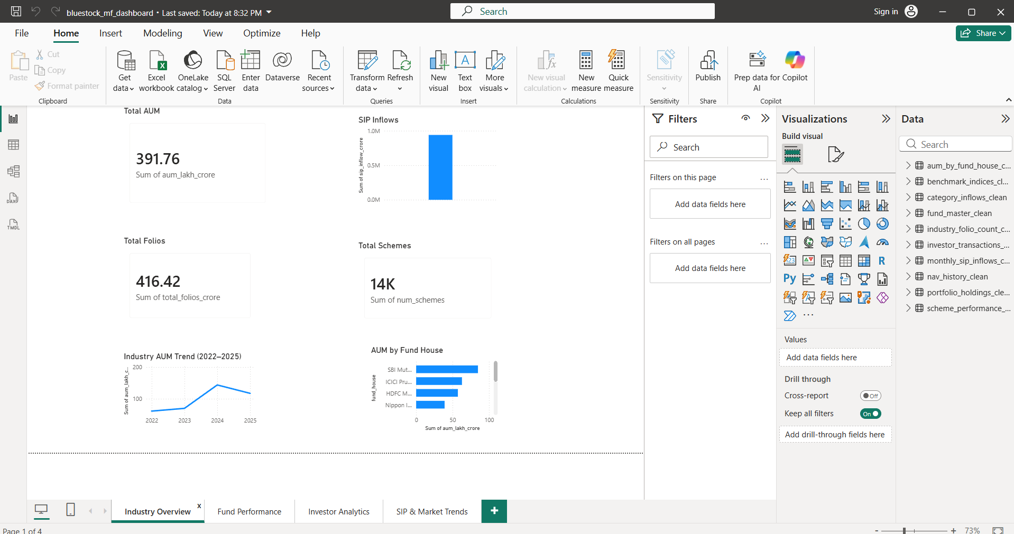
Dashboard Page 1
Industry Overview Dashboard
Features:
Total AUM
SIP Inflows
Total Folios
AUM Trend

Slide 10
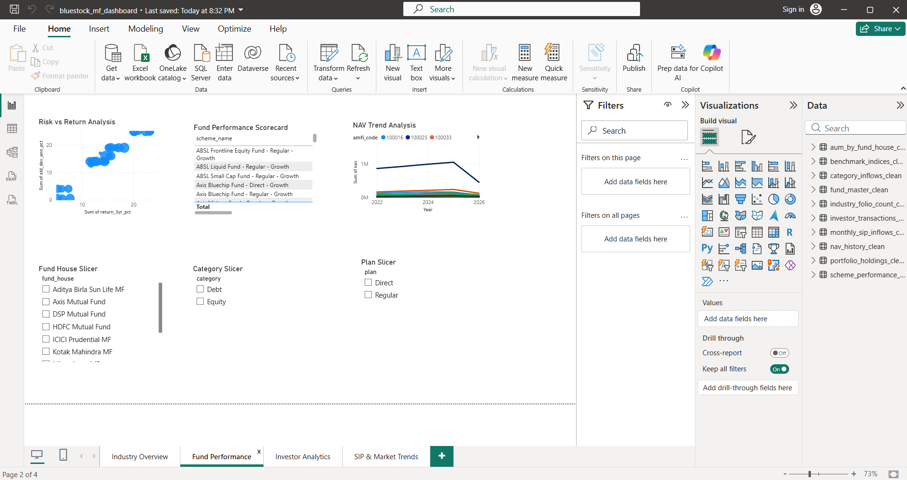
Dashboard Page 2
Fund Performance
Risk vs Return Analysis
NAV Comparison

Slide 11
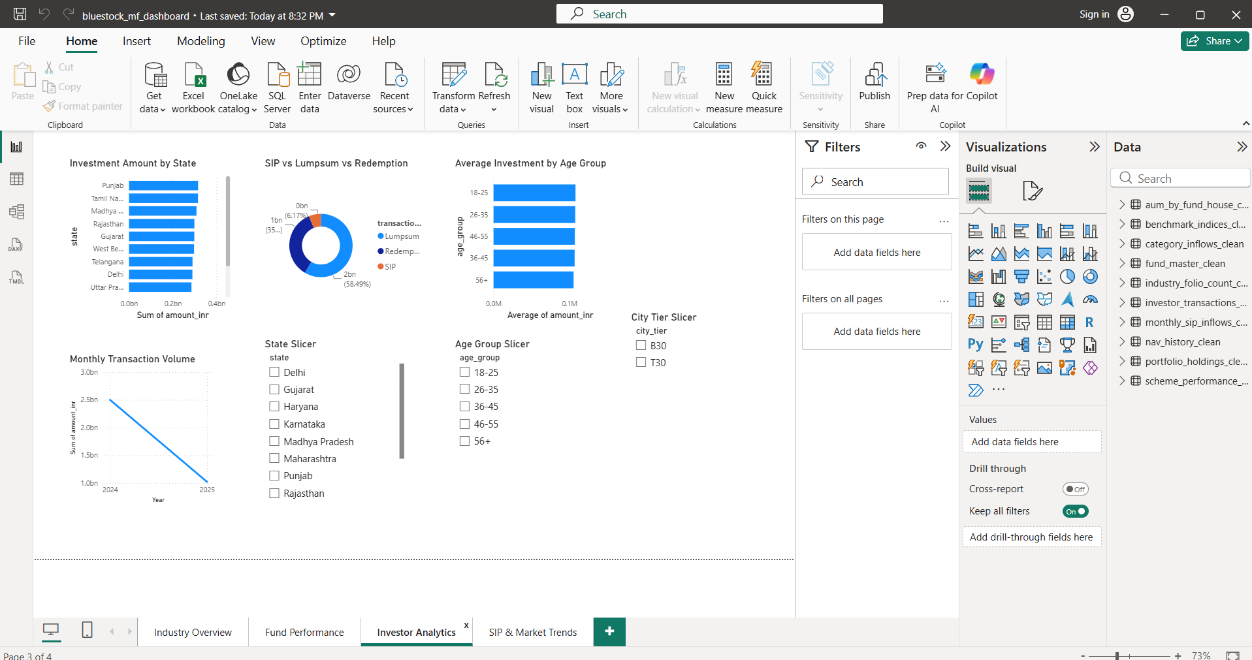
Dashboard Page 3
Investor Analytics
State-wise Investments
Investor Demographics

Slide 12
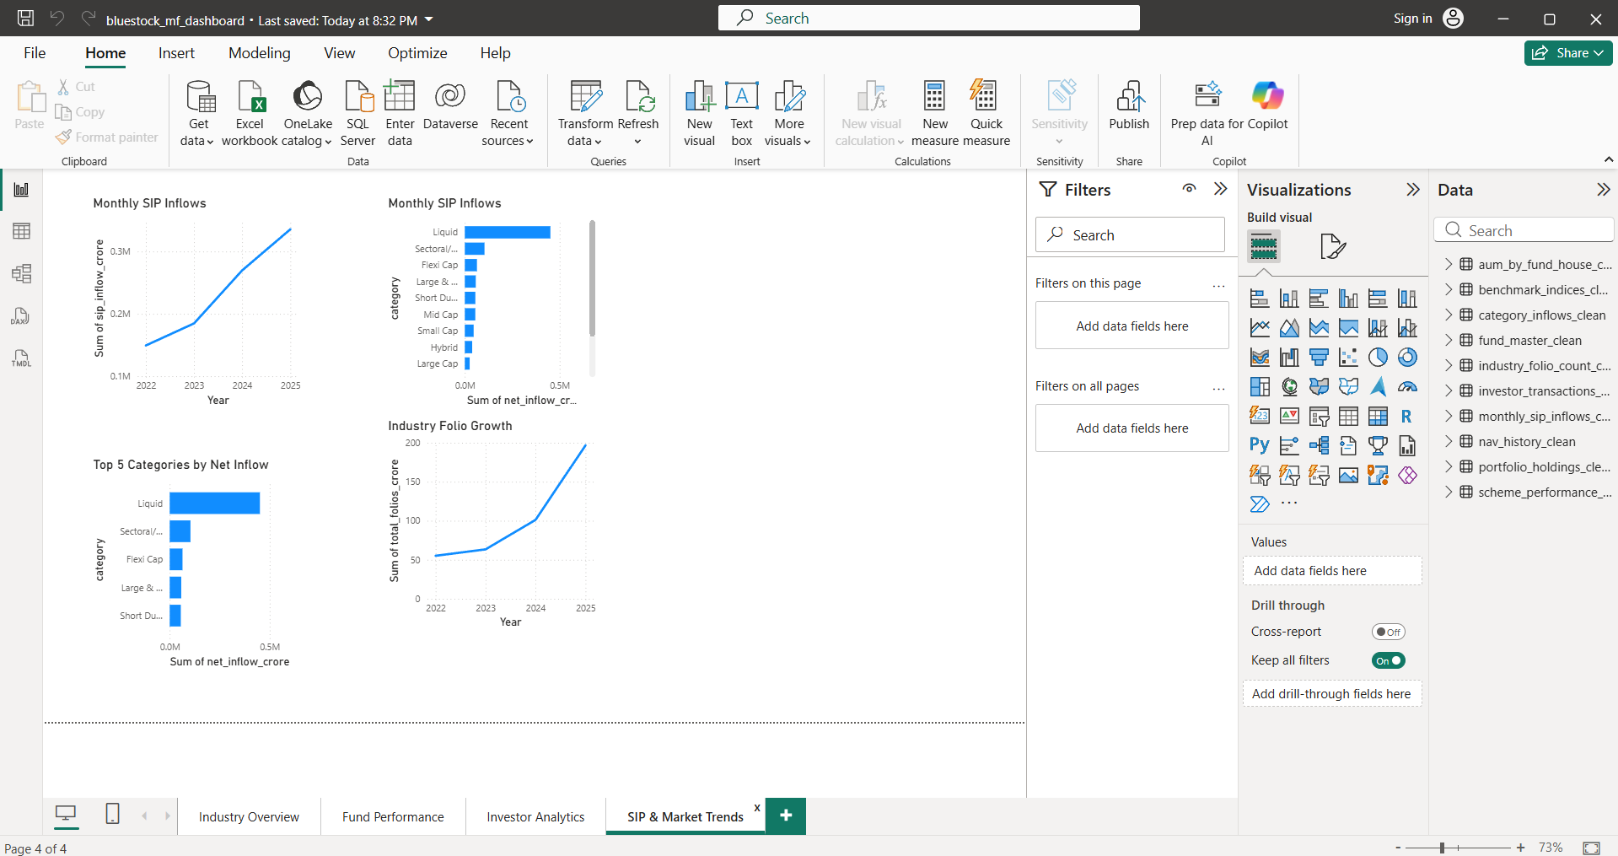
Dashboard Page 4
SIP & Market Trends
Category Inflows
Folio Growth

Slide 13
Key Findings & Recommendations
Key Findings
SIP adoption continues to grow
Equity funds remain investor preference
Risk-adjusted returns vary across funds
Some funds exhibit higher downside risk
Recommendations
Encourage SIP investing
Monitor downside risk
Diversify sector allocation
Improve investor retention

Slide 14
Conclusion
Successfully developed an end-to-end mutual fund analytics solution covering ETL, database design, EDA, performance analytics, advanced analytics, and dashboard visualization.

Slide 15
THANK YOU

